Slide 1

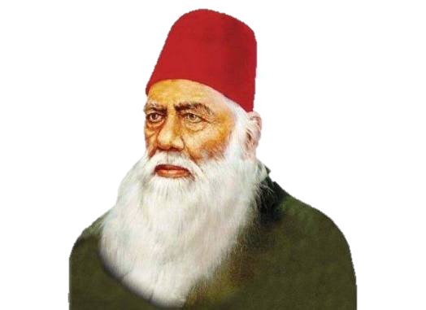
Aligarh Muslim University
Where Tradition Meets Excellence
Empowering young minds with knowledge, values, and a vision for a brighter future.

